Slide 1

IBM People Analytics
Attrition
Monthly Income
Yusi, Zhang

Slide 2
Introduction
Our goal is to identifying high-potential employees and reducing/preventing voluntary employee turnover (attrition).
Additional predict the monthly income regarding of the attrition.

Slide 3
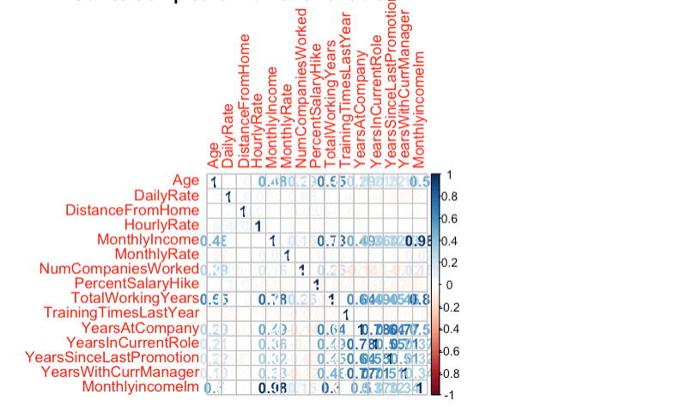
Data Description
There are 870 rows and 36 variables in the original dataset.
Columns are ’over 18’, ‘Employee Count’, ‘StandardHours’ are having the same value in the columns so we will ignore it.
Not clear columns HourlyRate, DailyRate, MonthlyRate, also shows there is no evidence those columns has impacts on attrition or monthly income.
No missing values in the dataset.

Slide 4
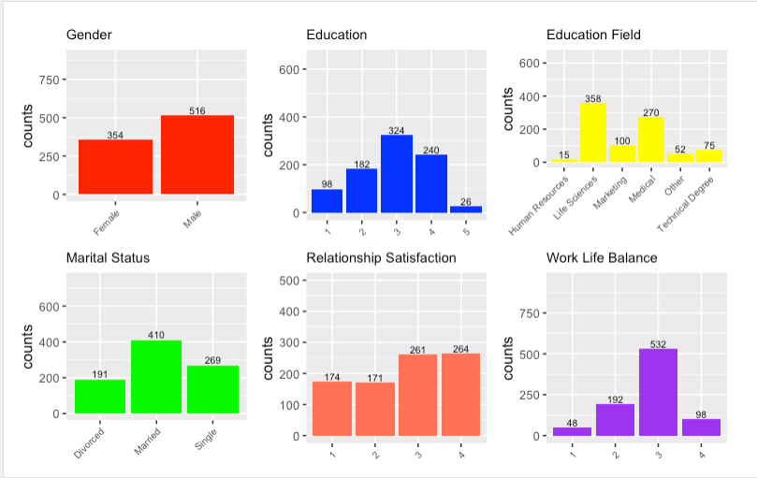
Explore data analysis
# More than 50% of Male employees
#Education: 1 'Below College 2 'College' 3 'Bachelor' 4 'Master' 5 'Doctor'; majority employees has bachelor degree, second one is master degree.
# More than 75% of employees are from life science or medical education backgroud.
# 45% of employees are married.
# Realtionship Satisfaction: 1 'Low' 2 'Medium' 3 'High' 4 'Very High'.
# 1 'Bad' 2 'Good' 3 'Better' 4 'Best'; looks like majority of employees think they have a better work like balance in IBM.

Slide 5
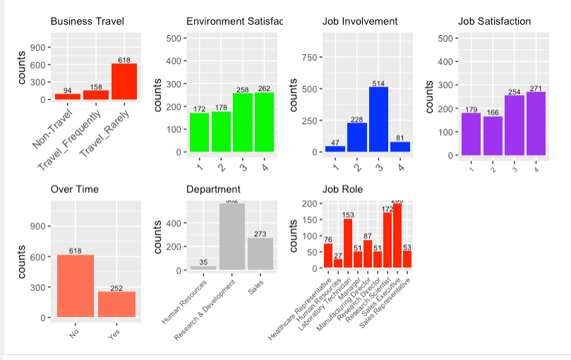
Explore data analysis

Slide 6
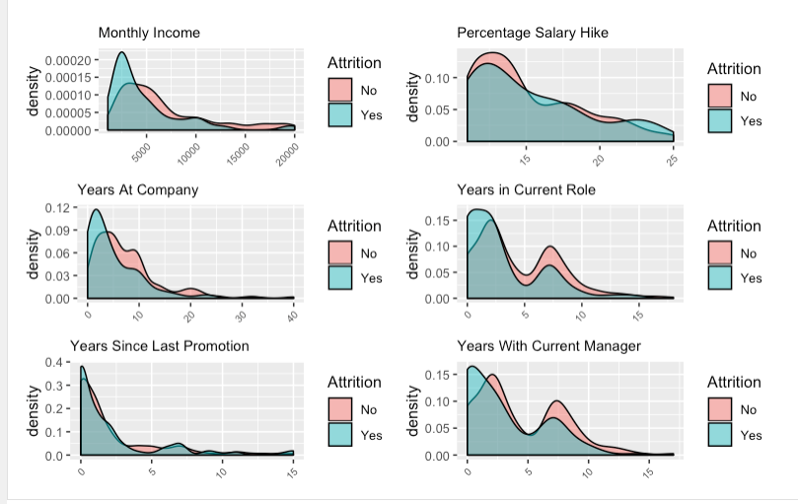
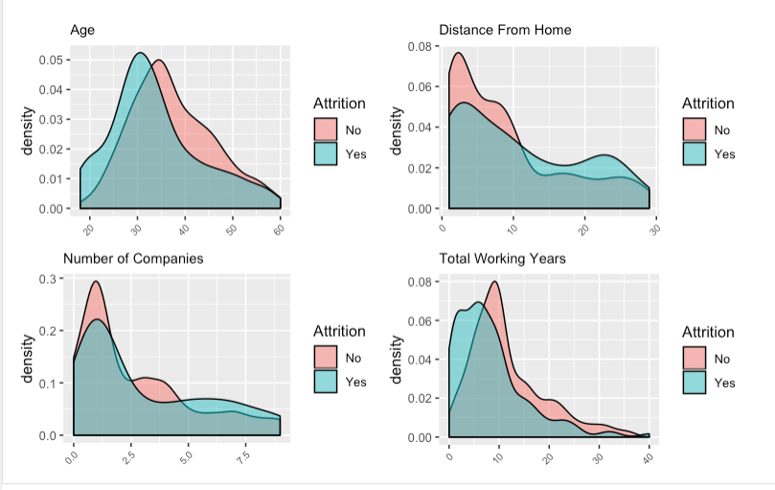
Explore data analysis Relationship between attrition and variables

Slide 7
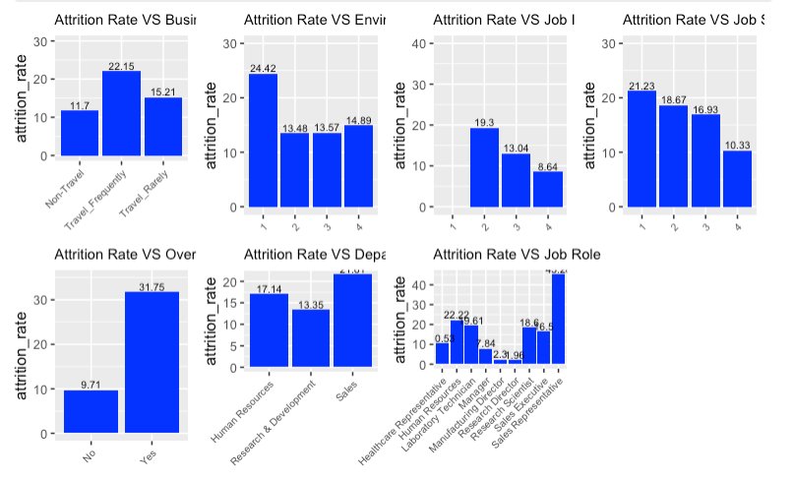
Feature Selection for Attrition
Top three factors of attrition:
Overtime
Job roles
Travel frequency

Slide 8
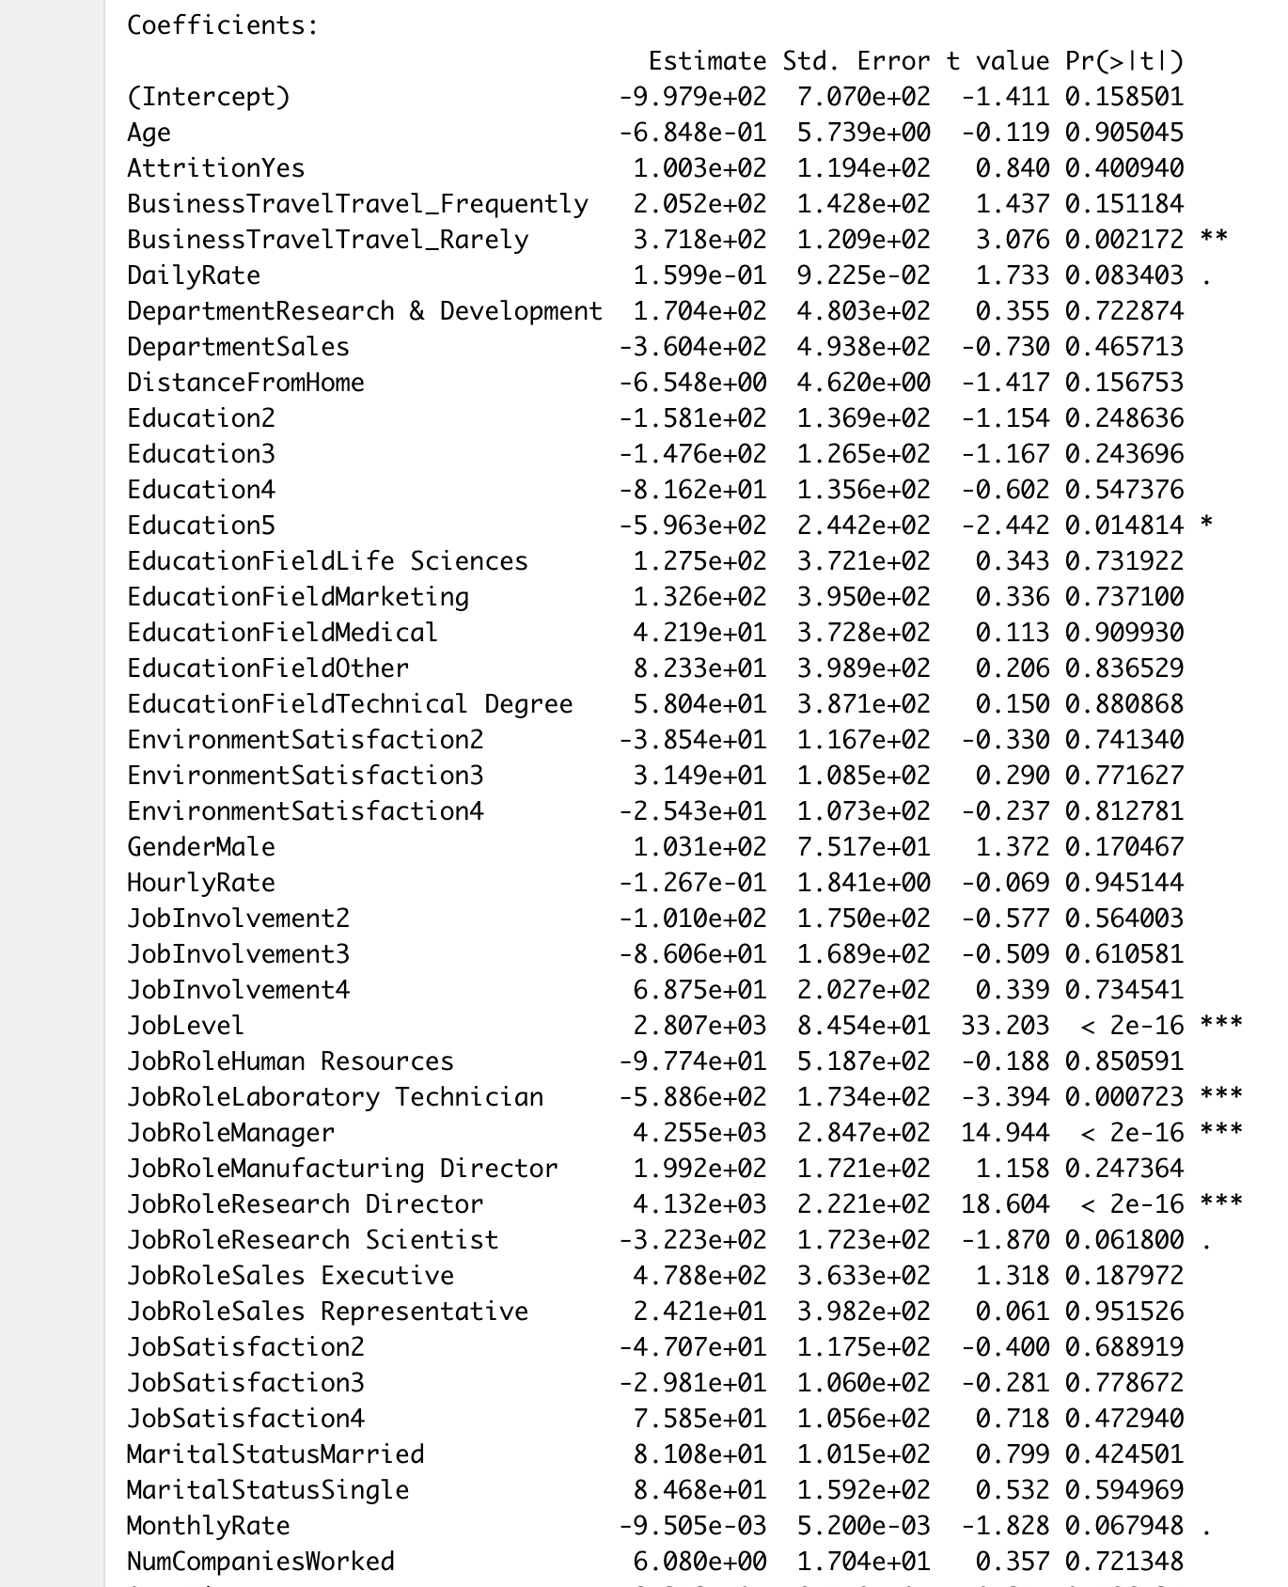
Key factors for Monthly Income
Business Travel: Travel rarely
Job level
Job Role Human resources/lab/research director/research scientist
Total year of working
Lowest p-value

Slide 9
Model & Result
Monthly Income: Linear Regression model with stepwise cross validation.
RMSE : 1031.125
Attrition: K Nearest Neighbor
Accuracy: 0.8448, Sensitivity: 0.8521, Specificity: 0.60.

Slide 10
Conclusion
For attrition, we need to focus on the candidates with “Yes” to overtime is more likely to leave.
Job roles is playing a big factor to attrition, sale reps are more likely to leave, but research employees are more likely will stay.
Candidates will have a lot of business travel are more likely to leave.

